Slide 1

Uber Rides and Weather

Slide 2
Team Members
• Lee Amstrong
• Julian Ravelo
• Damian Kifuso

Slide 3

Project Brief
No one likes to walk in subzero temperatures or scorching heat.
Do people use Uber more when the weather is uncomfortable?
Find out if people take Uber more during summer and winter months, and if there are relationships between daily temperature and ride frequency.
What do the results tell you.

Slide 4
Project overview
Exploring the Impact of Weather on Uber Usage
In our endeavor to comprehend the relationship between weather conditions and Uber usage, we perform analysis using a dataset encompassing Uber trips in New York City spanning from 2009 to mid-2015. Our primary focus lies in unraveling the intricate web of variables that dictate Uber's service usage patterns particularly with respect to seasons, weather conditions and their impact on temporal aspects of usage. To fortify our analysis, we've augmented the original dataset with essential weather-related data such as temperature and wind speed, sourced from the OpenWeatherAPI. Through data exploration of correlation, regression analyses and visualization techniques, we aim to answer critical questions. Are uncomfortable weather conditions correlated with heightened Uber usage? Do summer and winter months witness increased ride frequency? How does daily temperature influence ride demand?

Slide 5
Project Commencement
The project commenced with the upload of the 'Uber.csv' file and a Jupyter Notebook ('.ipynb') to a designated GitHub repository.
Successful, collaboration invitations were extended to project collaborators.
Subsequently, repository branches were established to foster parallel workstreams with each team member establishing a dedicated branch successfully within the repository.
Uber_Weather Project_Responsibilities:
Lee Armstrong:
Tasked with sourcing weather data from external sources.
Data analysis on the acquired weather dataset.
Comparison of weather against uber ride occurrence.
Julian Ravelo:
Data preprocessing, with a focus on cleaning and enhancing the dataset.
Following data preparation, undertake in-depth data analysis to elucidate patterns and insights related to Uber usage.
Damian Kifuso:
Damian's specific roles and tasks within the project are currently under development and will be outlined in the near term.

Slide 6
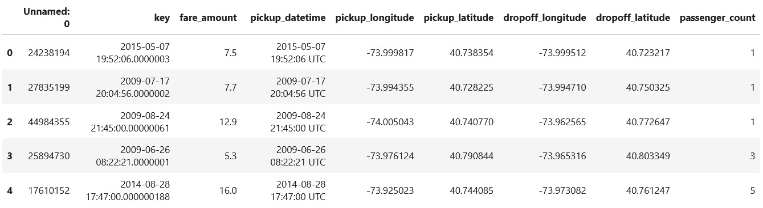
Uber_df
The Uber dataset includes information such as the precise date and time of each Uber journey, denoted as 'pickup_datetime' along with latitude and longitude coordinates. We will undertake a data extraction process to retrieve these details, followed by a call to the OpenWeather API to procure weather information corresponding to the exact 'pickup' moments.
Display output of printed Uber data frame head ( )

Slide 7
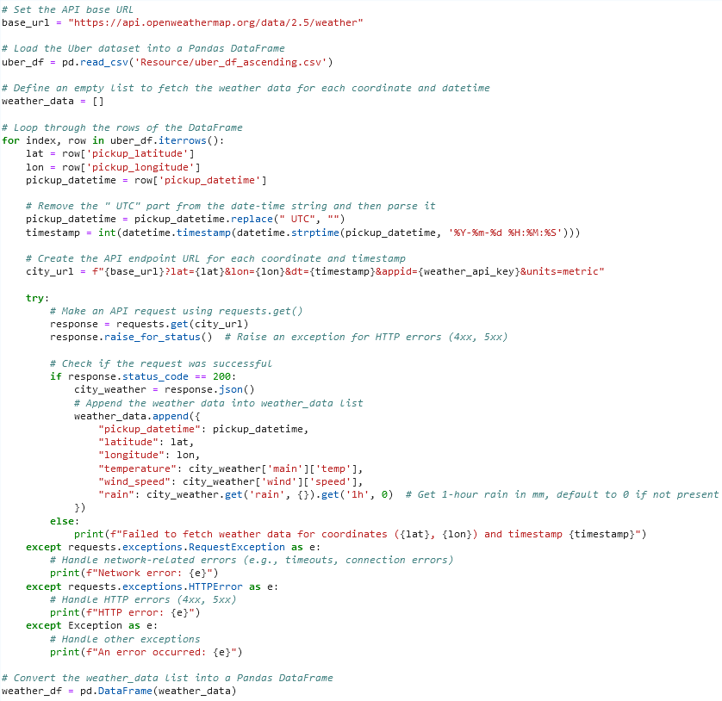
Weather api
This code is designed to process each row of an Uber ride pickup dataset and extract key information, including coordinates and timestamps. Subsequently, it constructs an API URL to retrieve weather data from OpenWeatherMap, incorporating these details. The retrieved weather information is then stored in the 'weather_data' list. The code incorporates error handling mechanisms for various potential issues during API requests. The resulting 'weather_data' list becomes a comprehensive repository of weather-related information, corresponding to each Uber ride pickup entry in the original dataset.
The code utlises a loop to iterate through the rows of the 'uber_df' DataFrame, extracting latitude, longitude, and pickup datetime for each row. It further converts the datetime into a Unix timestamp, facilitating API URL creation with pertinent information. The code initiates API requests to OpenWeatherMap to fetch weather data specific to each coordinate and timestamp.
Upon making an API request, the code scrutinizes the response status code to ascertain the request's success. When the status code is 200 (indicating a successful request), it proceeds to extract temperature and wind speed information from the JSON response. This data, along with the original pickup datetime and coordinates, is added to the 'weather_data' list. Conversely, if the status code is not 200 (signifying a failed request), the code adeptly prints an error message, detailing the unsuccessful weather data retrieval for the given coordinate and timestamp.
Furthermore, the code encompasses exception handling procedures to anticipate potential errors during the API requests. It employs specific exception categories and a comprehensive 'Exception' catch-all block to handle any unforeseen exceptions. In the event of exceptions, the code communicates the encountered issue during the data retrieval process but continues to extract the data without failure, ensuring robustness while continuing the task until completion.

Slide 8
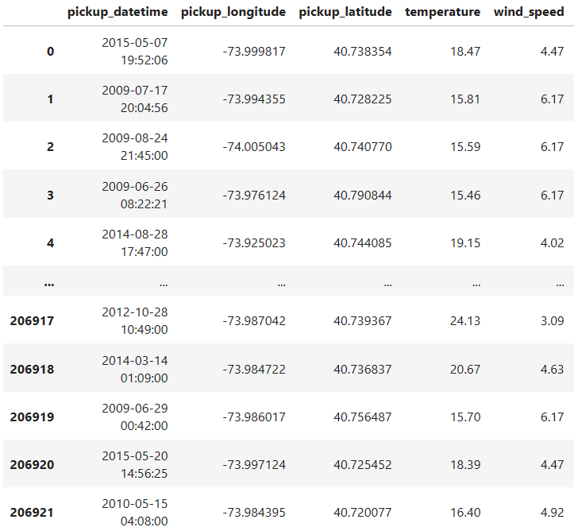
Uber_Weather_df
Combining the original uber ride information dataset and the values successfully received from the weather api an Uber_Weather.csv file was created.

Slide 9
Pose Hypothesis
The hypothesis for this data analysis project could be framed as follows:
Alternative Hypothesis (H1): Weather conditions have a significant correlation with Uber ride frequency. Specifically, extreme weather conditions, such as very high or very low temperatures and heavy rainfall, lead to an increase in Uber ride demand. Seasonal patterns, particularly in summer and winter, significantly influence ride frequency.
Null Hypothesis (H0): Weather conditions (such as temperature, wind speed, and rainfall) have no significant correlation with Uber ride frequency. Seasonal variations do not impact ride demand. In other words, there is no statistically significant difference in the frequency of Uber trips under different weather conditions.
My personnel thinking was certainly with all this data we have gathered, a clear and significant correlation between very hot or very cold temperatures causing high demand as well as a clear visual indicator that high end wind speed would cause more frequent use of the Uber service.

Slide 10
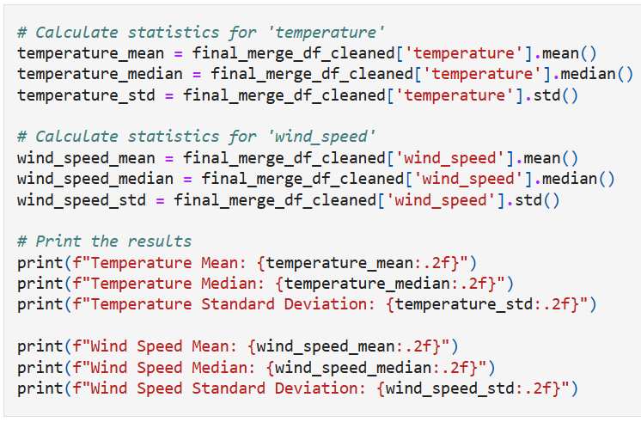
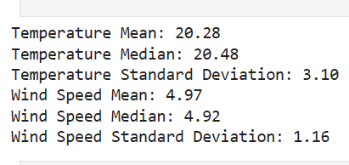
CODE & Output
In this code snippet, we're conducting essential data analysis on weather data from the 'final_merge_df_cleaned' dataset. Specifically, we're focusing on two critical weather variables: temperature and wind speed. For temperature we calculate its mean, median and standard deviation. While for wind speed, we perform the same statistical analysis.

Slide 11
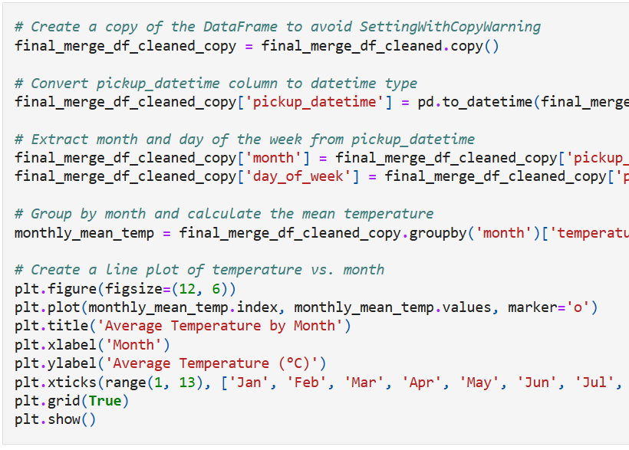
Code
This code converts a column named 'pickup_datetime' to the datetime data type, enabling time-based analysis. Then, it extracts and adds two new columns: 'month' and 'day_of_week' which represent the month and day of the week respectively, derived from the 'pickup_datetime' column. Subsequently, the code groups the data by 'month' and calculates the mean temperature for each month. Finally, it generates a line plot illustrating the average temperature over the months, providing a visual representation of how temperatures vary throughout the year.

Slide 12
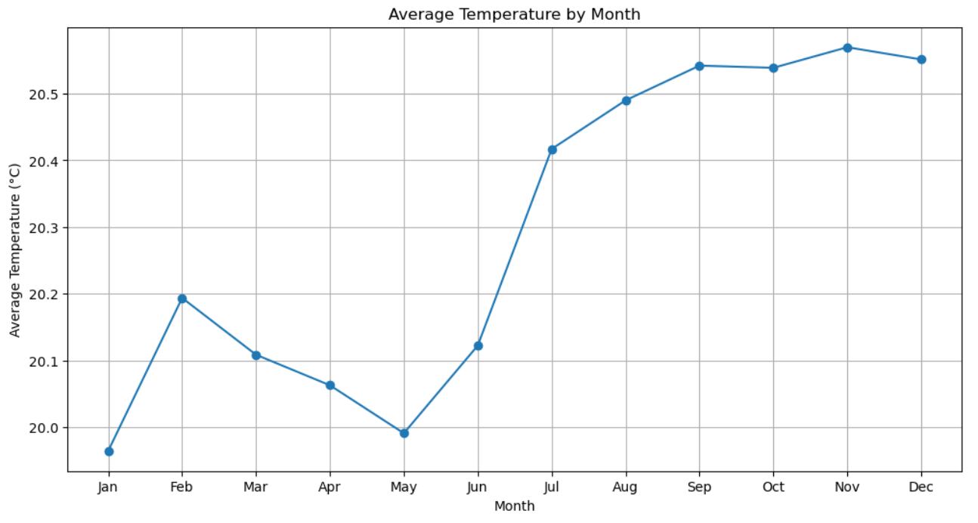
Output
With the average temperature per month plotted, you can observe what seems a significant change from the first six months to the following six months. However, noting only a 1-degree Celsius difference on the y-axis suggests that the temperature data might have been collected under controlled conditions or with some outliers removed. This could imply that the original dataset was filtered for some specific research or analysis purpose. The relatively narrow temperature range within the same city, especially when compared to a two hundred thousand row dataset with an almost six-year timeframe raises the possibility of pre-processing or data cleaning that might have been applied to the dataset prior to our download.

Slide 13
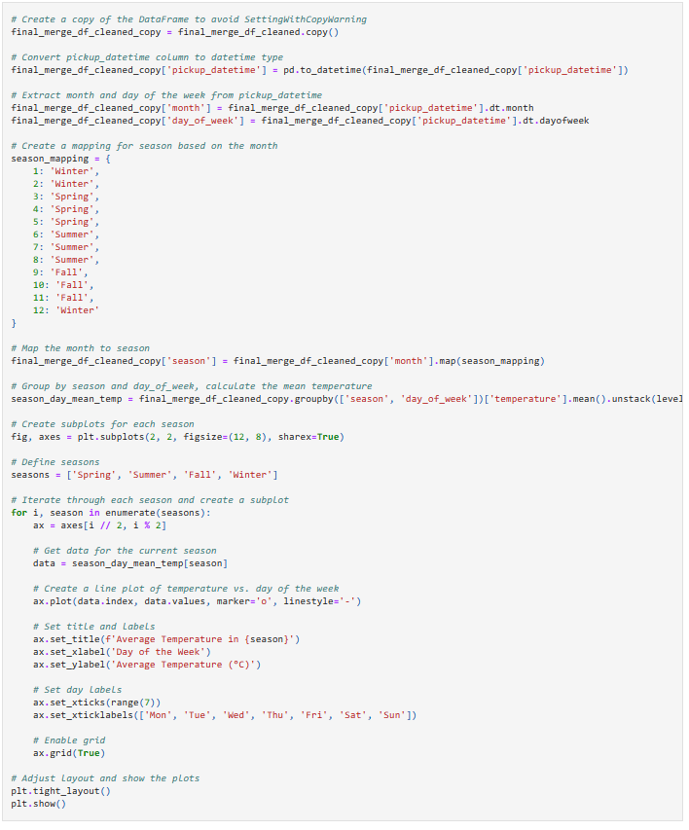
Code
In this code, we endeavor to explore how average temperatures fluctuate throughout the year, considering both seasons and days of the week. It begins by converting the date and time data into a usable format and creating a mapping for seasons. The data is then grouped and analyzed to calculate the mean temperature for each season and day of the week. The results are presented in a visually compelling manner using subplots, with each subplot representing a different season. The line plots showcase how temperatures vary across the days of the week within each season.

Slide 14
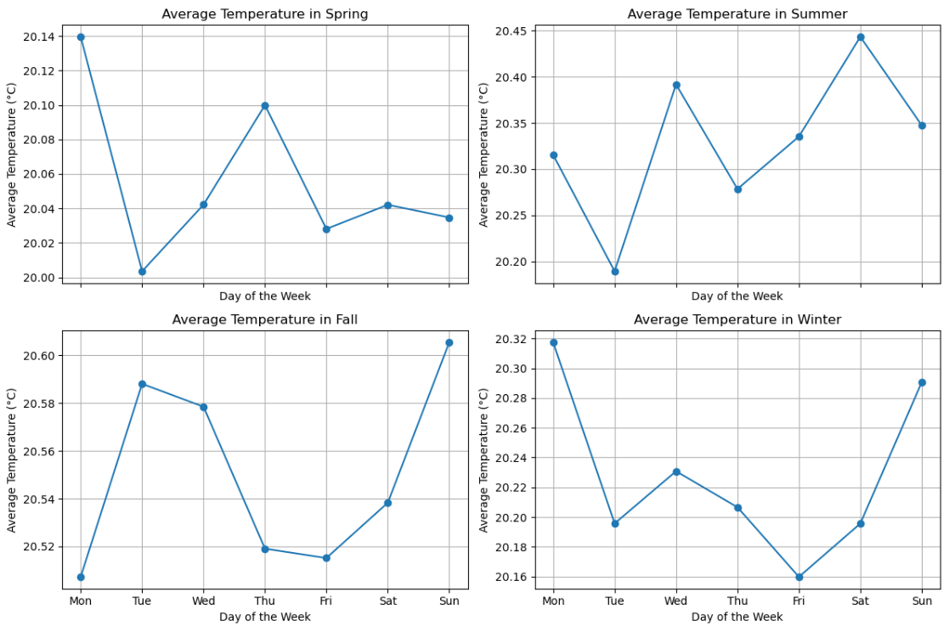
Output
Looking at the average temperature for each day of the week within a specific season, we notice variations, but these changes appear considerable. However, considering the y-axis scale the observation suggests that while there are fluctuations in temperature throughout the days of the week within a given season, these variations are not dramatic. The narrow range on the y-axis indicates that temperature remains relatively consistent, reinforcing the notion that the dataset may have been collected under controlled conditions or with outliers removed.

Slide 15
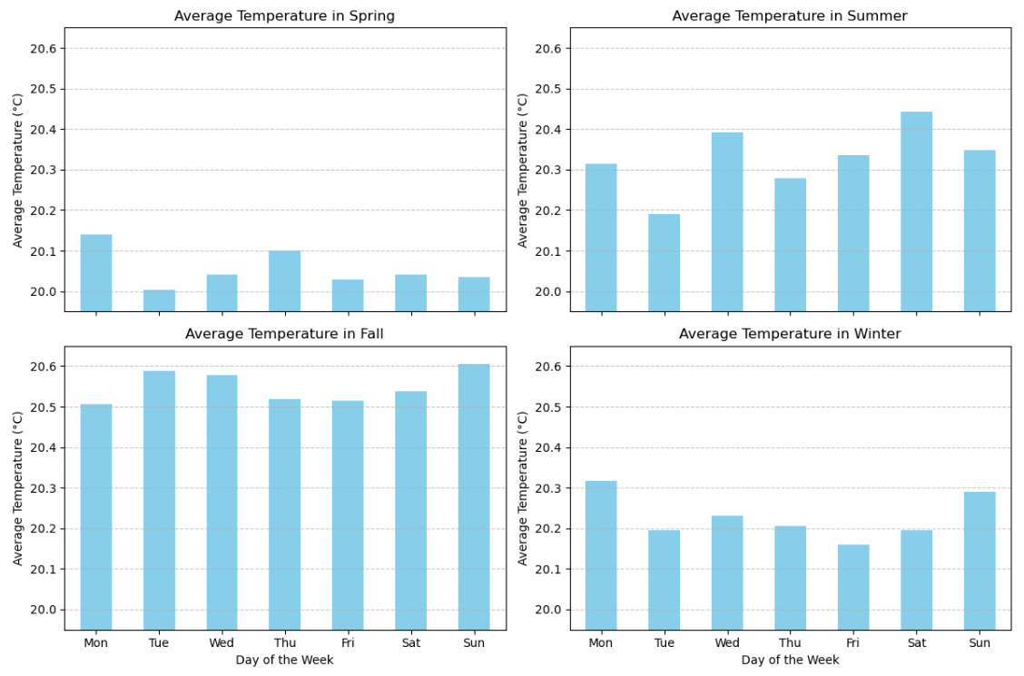
Output
Switching the visualization to a bar chart and adjusting the Y-axis range to encompass the minimum and maximum data points for all seasons, we can observe that the variations in the data become less pronounced.

Slide 16
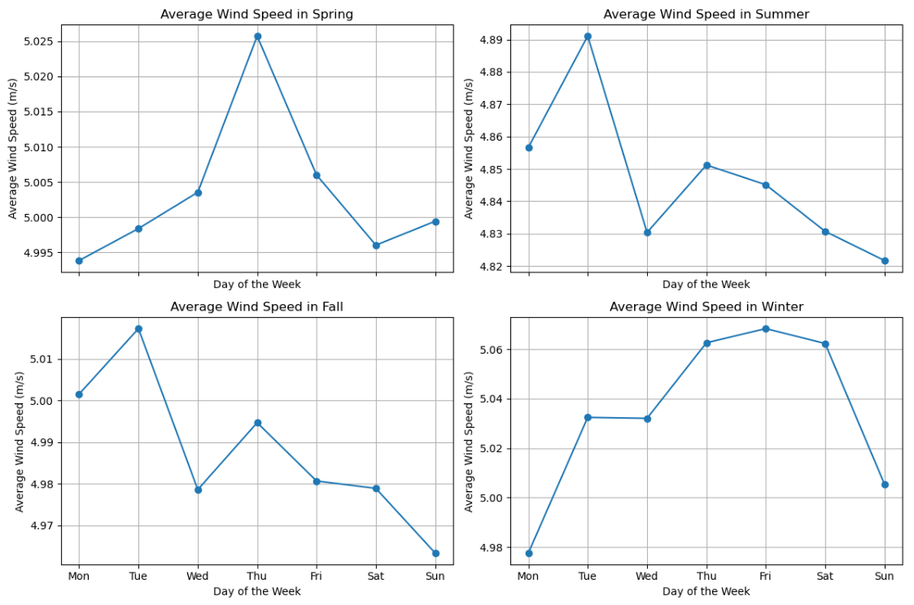
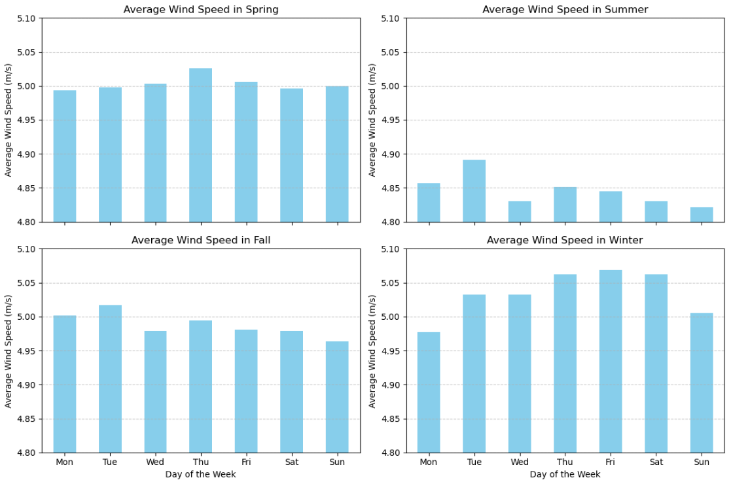
Output
The same can be observed for the wind speed data

Slide 17
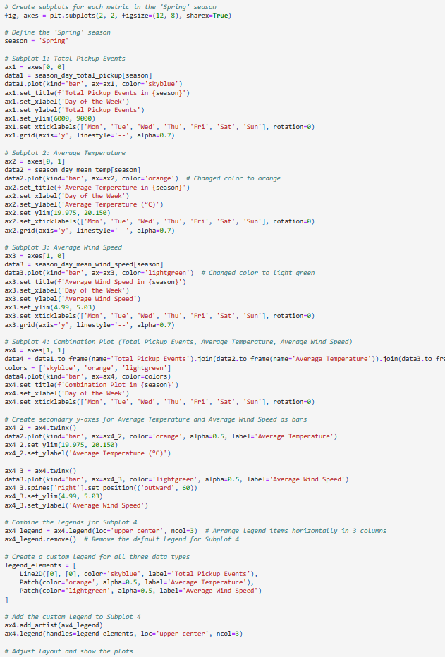
Code
This code makes use of the Matplotlib library to create a multi-subplot visualization presenting various metrics for the 'Spring' season.
Firstly, a 2x2 grid of subplots is defined within a figure laying the groundwork for the subsequent visualizations. The chosen season for analysis is 'Spring,' and each subplot serves a distinct purpose. In Subplot 1, the total pickup events per day of the week are depicted as bars. Subplot 2 displays the average temperature for each day of the week in 'Spring' and Subplot 3 illustrates the average wind speed, both employing bar plots.
Subplot 4, the most intricate combines data from the previous subplots showcasing total pickup events, average temperature and average wind speed. It also introduces a secondary y-axes for temperature and wind speed as bars and a custom legend for the three data types in Subplot 4. Throughout this process, careful attention is paid to setting appropriate y-axis limits as well as adding informative labels and legends.

Slide 18
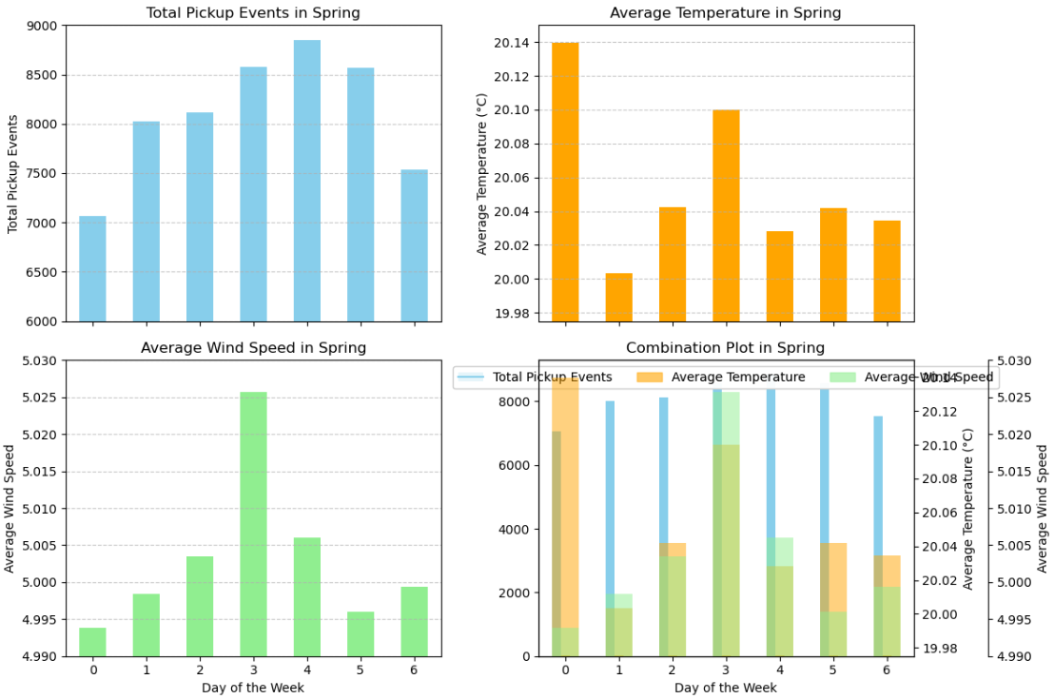
Output
Looking at the visual representation created by this code we can notice a breakdown of key metrics for the 'Spring' season. In the top-left subplot we see the total pickup events per day of the week which represents and displays the average number of uber rides, while the top-right subplot unveils the average temperature variations. In the bottom-left subplot average wind speed. Lastly, the bottom-right subplot combines the three. Presenting a view of the season's dynamics.

Slide 19
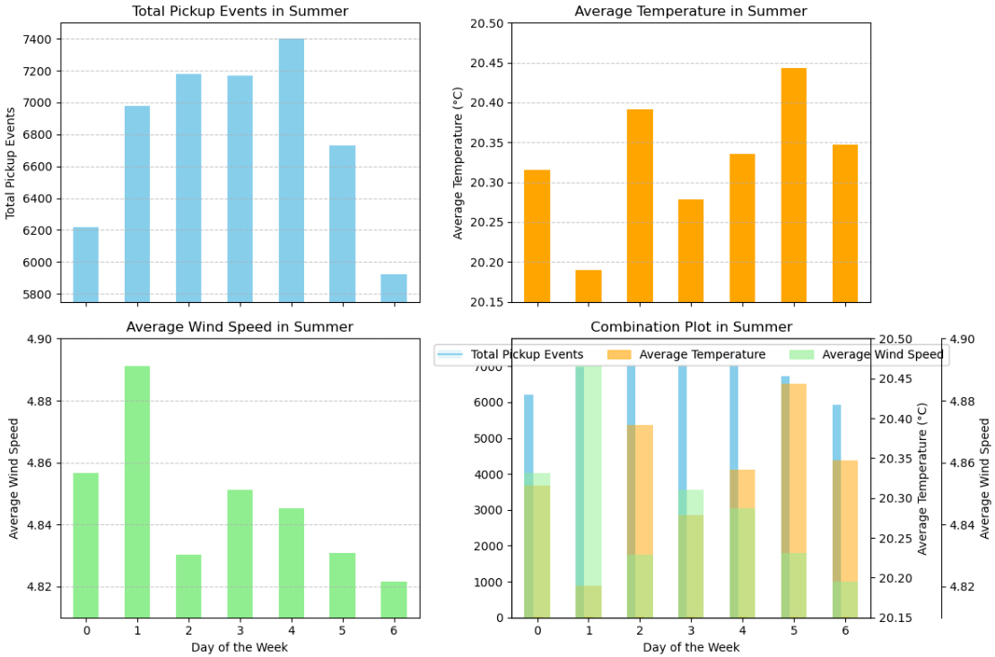
Output
The same can be observed for the Summer data

Slide 20
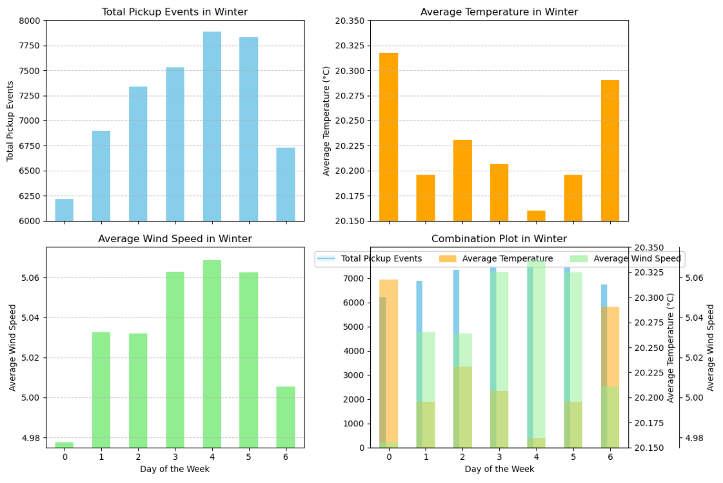
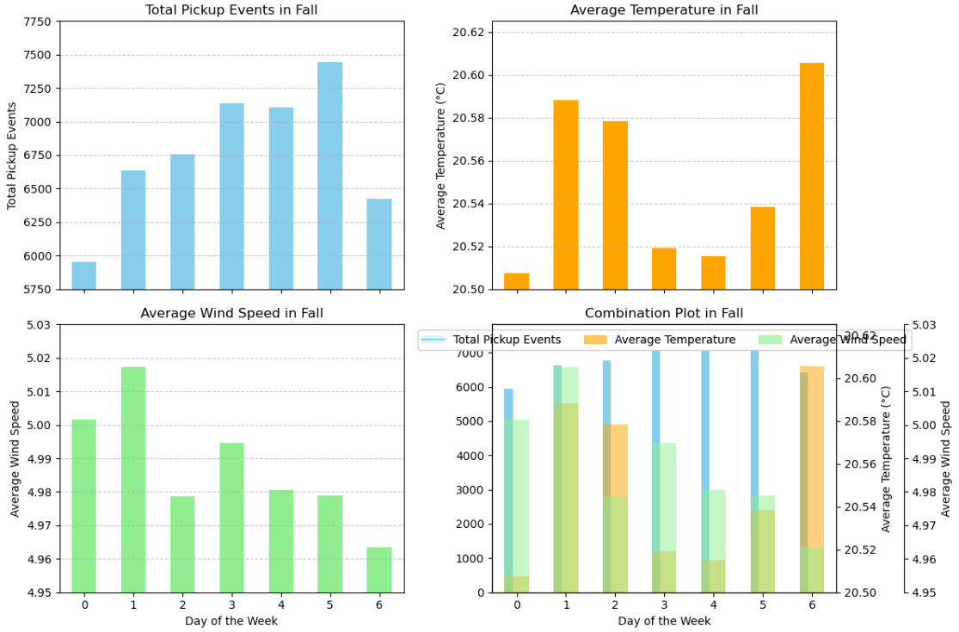
Output
The same can be observed for the Winter & Fall data

Slide 21
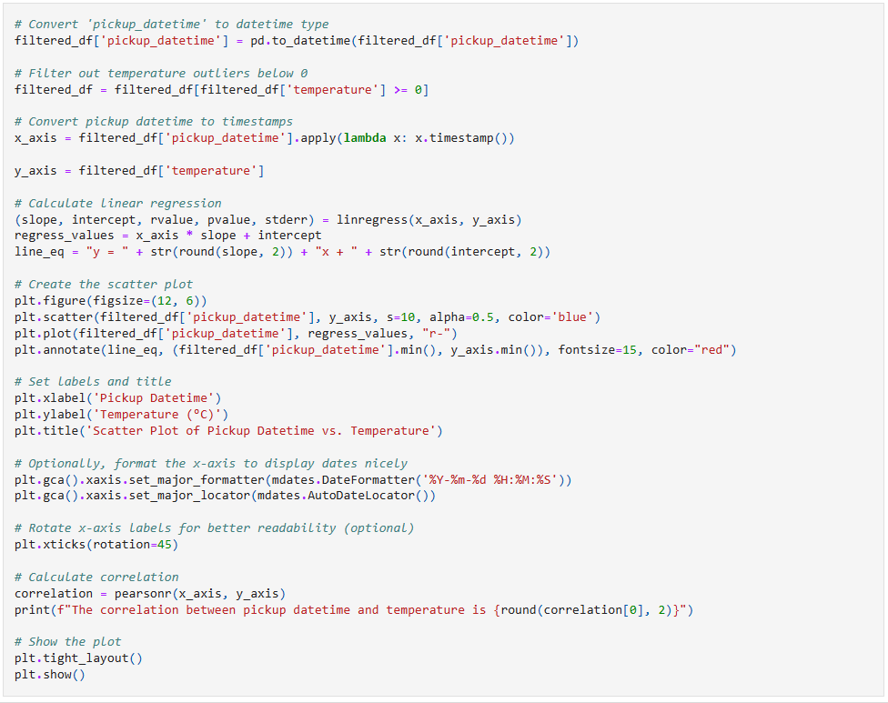
Code
This code conducts an analysis of the relationship between each uber ride as 'pickup_datetime' and 'temperature’ at the time of that uber pick up in a dataset. It begins by preparing the data, converting datetime values and eliminating temperature outliers below 0°C. A linear regression model is then applied to assess the association between timestamps and temperature.
Annotations provide the equation of the regression line. Labels, titles, and optional date formatting enhance the plot's clarity. The correlation coefficient quantifies the relationship between datetime and temperature. This code provides an exploration of how temperature fluctuates concerning pickup datetime, enabling both visual interpretation and quantitative analysis of the dataset.

Slide 22
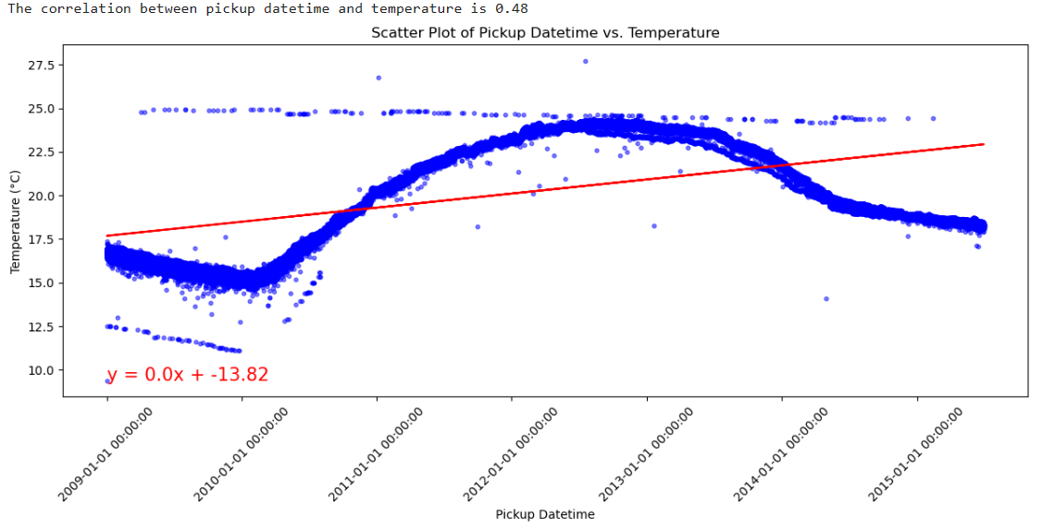
Output
The resulting scatter plot presents the data points and overlays a red regression line, highlighting the trend.

Slide 23
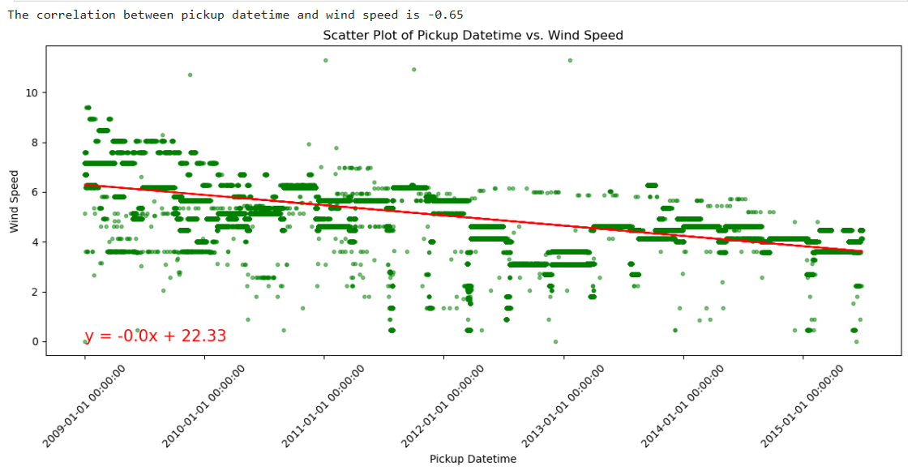
Output
The same code is used with temperature changed to wind speed

Slide 24
Scatter Plot Summary
The correlation between pickup datetime and temperature is 0.48, indicating a moderate positive relationship. The slope (0.0) is nearly flat, suggesting that the change in temperature as time progresses is very minimal. This could be interpreted as a tendency for occurence of uber trips to increase slightly as temperature rises however it would be more likely that there is a tendency for temperature to rise as the day progresses as well as perhaps a tendency for higher volume of uber demand as the day progresses.
The correlation between pickup datetime and wind speed is -0.65, indicating a moderate negative relationship. The negative slope, suggesting that as pickup datetime increases, wind speed tends to decrease. The slope (-0.0) is nearly flat, suggesting that the change in wind speed as time progresses is minimal.

Slide 25
Who would have Uber believed it!
In conclusion, while it might seem like we've hit a roadblock in our quest to unravel the secrets of weather's influence on Uber rides, it's safe to say that extreme weather conditions do play a role in people's choice to opt for an Uber ride over a leisurely stroll. The challenge lies in peeling back the layers and diving even deeper into the data ocean. To do justice to this inquiry, we'd need to cast a wider net and gather more data on factors like whether a trip is a job necessity, the sway of special events, and the availability of alternative transport options. Plus, let's not forget those elusive outliers that might hold the key to unlocking even greater insights.

Slide 26



Methodology using original dataset
Notes:
Julian

Slide 27

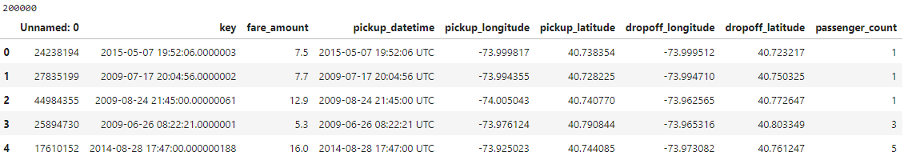
Methodology
Through summary tables and graphs, we were able to clean the data and answer the research questions.
Notes:
Julian

Slide 28

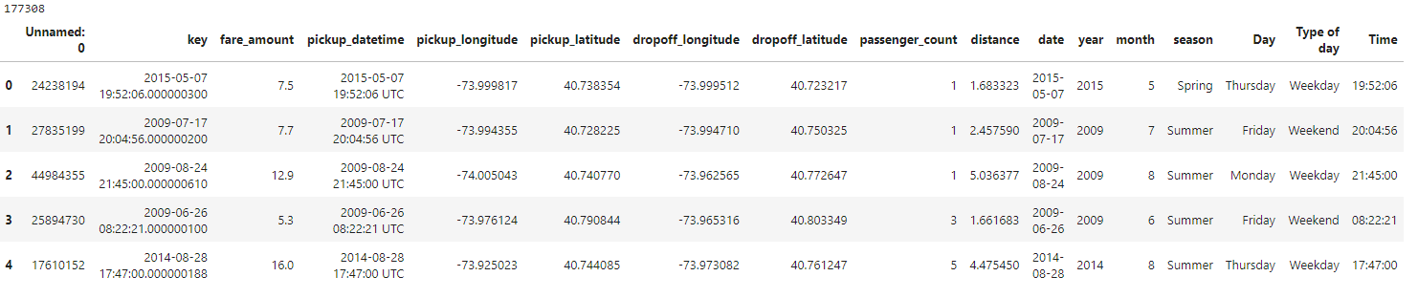
Methodology – Cleaning dataset
First 5 rows after the dataset was cleaned and some columns of interest were added (177k rows)
Notes:
Julian

Slide 29
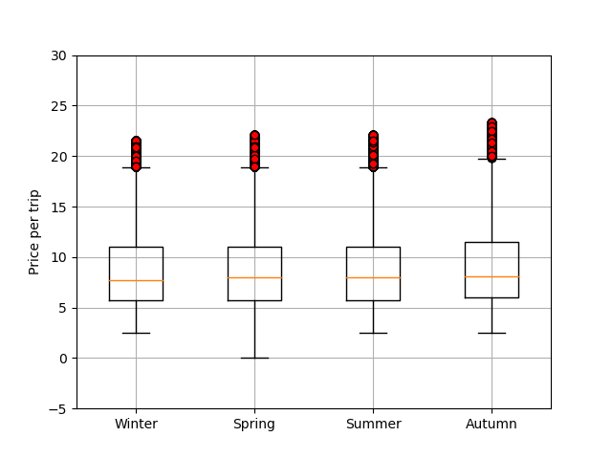
Methodology Boxplot
Showing the distribution of the data after it was cleaned
Notes:
Julian

Slide 30
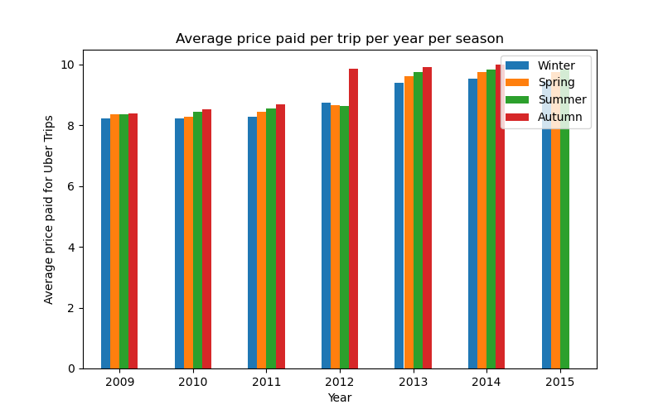

Results
Is the price of an Uber trip dependent on the weather/season?
We can conclude that the average price shows a similar behavior in most of the years with Winter being the lowest average price and Autumn with the highest average price. Only 2012 shows a higher difference on the price paid in Autumn but the graph indicates that from 2012 the rates were increased.
Notes:
Julian

Slide 31

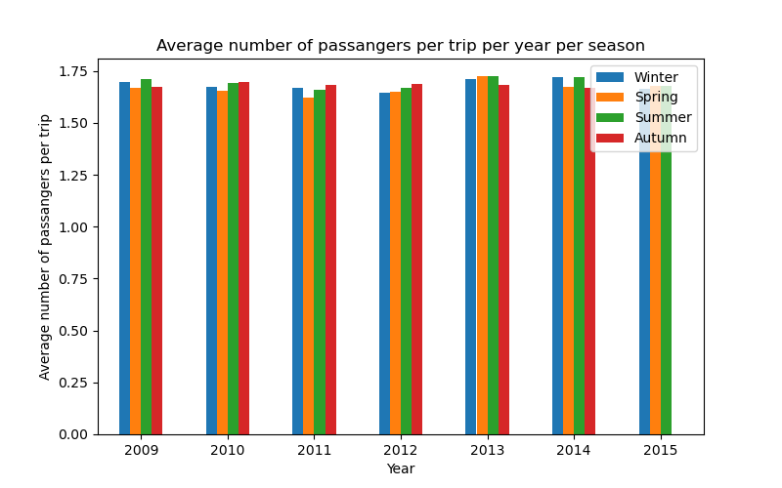
Results
Relationship between the number of passengers and the weather conditions/season when using Uber
From the graph, we can conclude that there is no relation between the season and the number of passengers per Uber trip. The values are quite similar independently of the season and the year.
Notes:
Julian

Slide 32
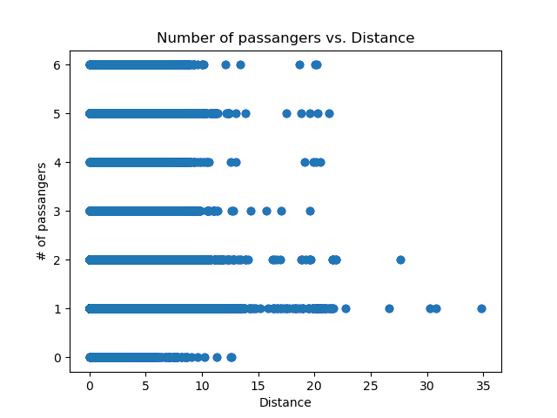

Results
Relationship between the number of passengers and the distance travelled when using Uber
As shown in the image, and by getting a 0.0 value for the correlation factor, we can conclude there is no relation between the number of passengers and the distance of the Uber trips.
Notes:
Julian

Slide 33

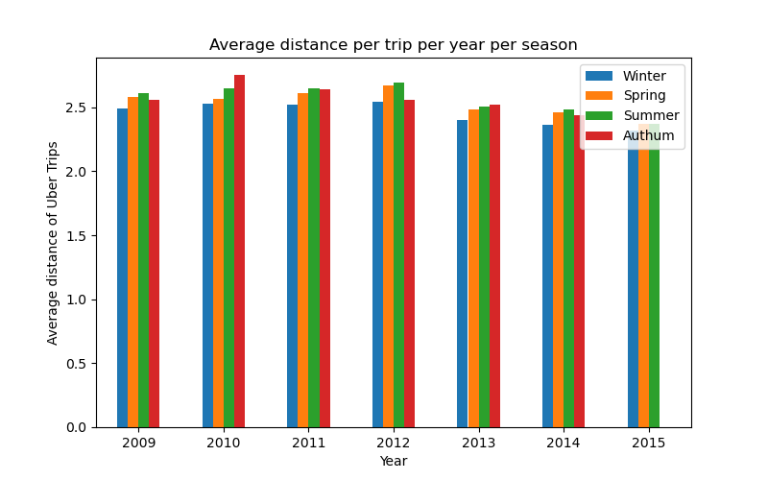
Results
What is the relation between the weather conditions and the distance travelled when using Uber?
As shown on the graph, Winter is the season with shortest average distance for Uber trips. Whereas Autumn and Summer have the longest average distance.
Notes:
Julian

Slide 34

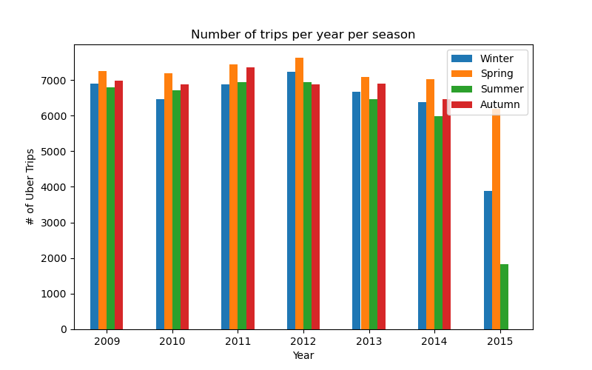
Results
What is the relation between the season and the usage of Uber?
As shown in the graph, the number of trips per season is consistent through the years. Spring and Autumn are the seasons of the year with higher usage of Uber in most of the years while Winter and Summer are the season with fewer trips.
Notes:
Julian

Slide 35

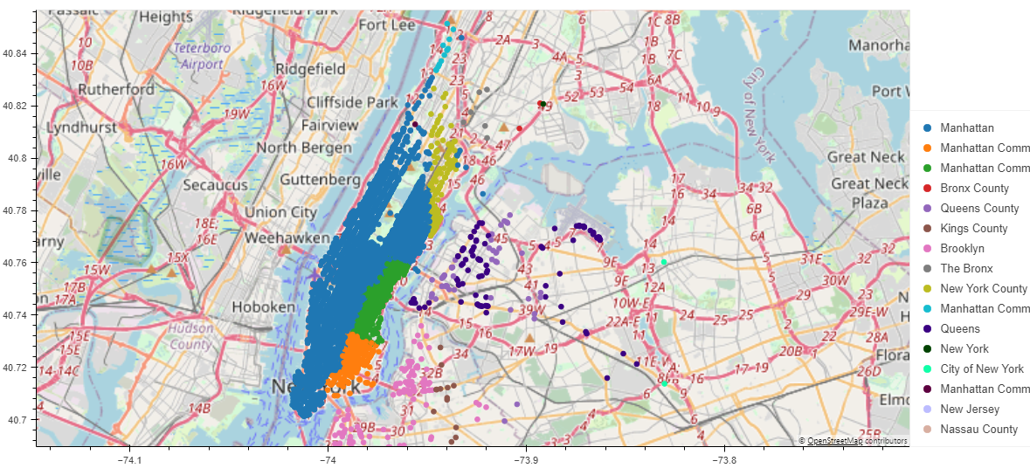
Results
Is the usage of Uber mainly urban or rural?
As shown, we plotted the distribution of Uber trips per administrative category of New York City. 77% of the Uber trips for 2015 are from Manhattan area.
Notes:
Julian

Slide 36
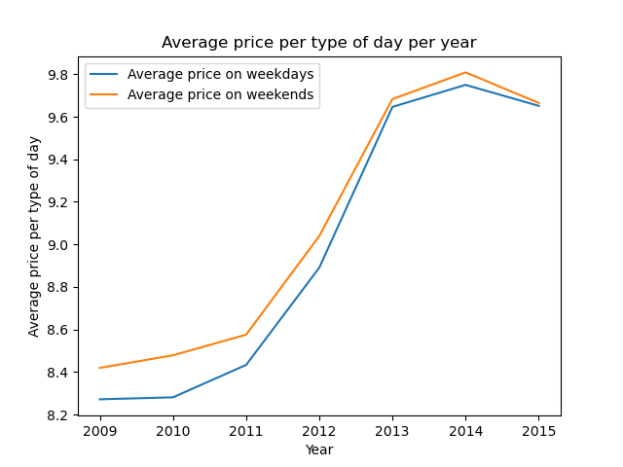

Results
Does the cost/usage of Uber depend on the pick-up times? (peak hours, weekdays, weekends, etc.)
Additionally, the price paid during the weekends is consistently higher for all the years as shown on the graph.
Notes:
Julian

Slide 37
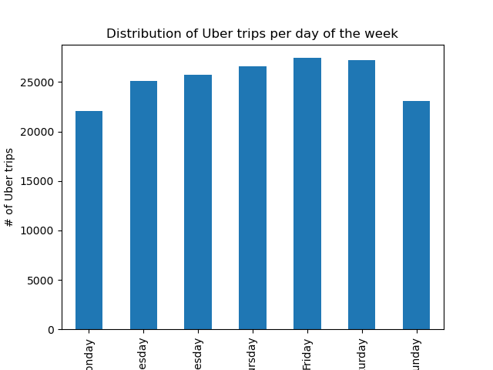
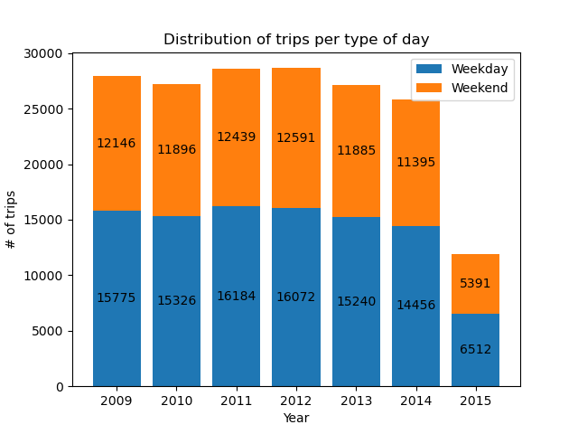
Results
Does the cost/usage of Uber depend on the pick-up times? (peak hours, weekdays, weekends, etc.)
Notes:
Julian

Slide 38
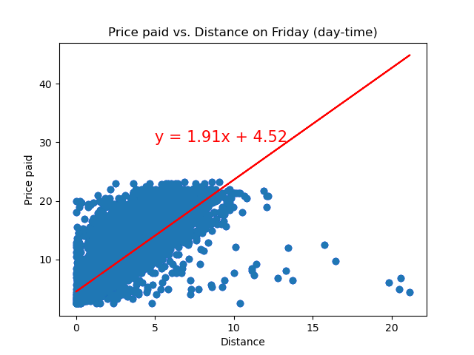
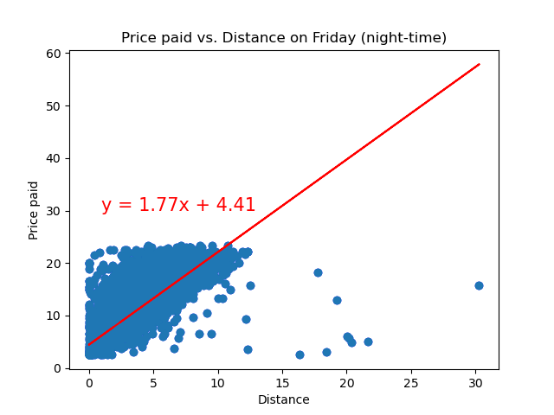
Results
Does the cost/usage of Uber depend on the pick-up times? (peak hours, weekdays, weekends, etc.)
Notes:
Julian - For instance, a 10km trip will cost around $22.11 during the night while during the day it will cost $23.2, 6% more.

Slide 39
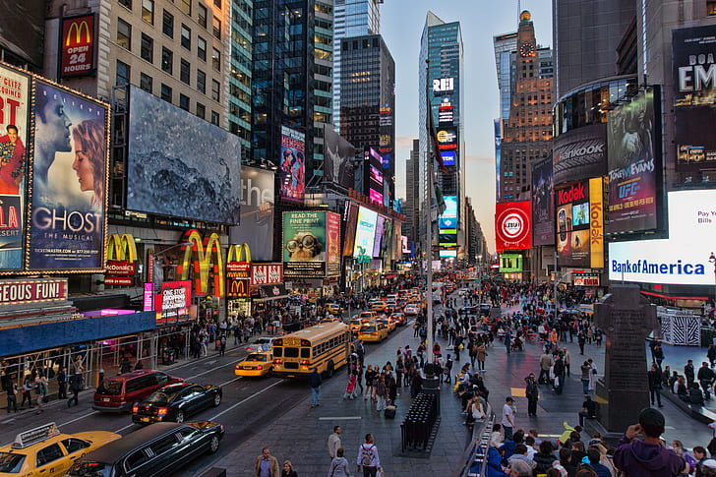
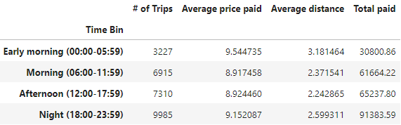
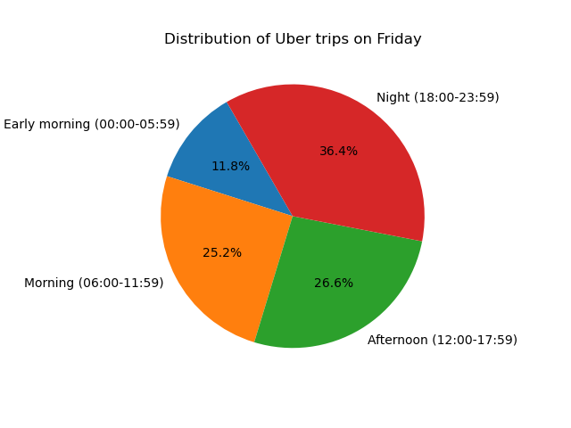
Results
Does the cost/usage of Uber depend on the pick-up times? (peak hours, weekdays, weekends, etc.)
Notes:
Julian - The average price paid for an Uber trip between midnight and 6 a.m. is $9.54, 7% higher than the cheapest period of time which is between 6 a.m. and mid-day.

Slide 40

Thanks!

